Slide 1
Correspondence
CHAPTER: 6

Slide 2
Business Letters Types
Invitations
Instructions
Answer to Inquiry
Complaint
Adjustment
Reference
Advice
Introducing new business
Amalgamation of business
Acknowledgement
POSITIVE
NEGATIVE
NEUTRAL
PERSUASIVE

Slide 3
Correspondence Guidelines
1. Know Your Purpose
The purpose sentence often becomes one of the first sentences in the document.
Letter purpose sentence: “As you requested yesterday, I am sending samples of the new candy brands you are considering placing in M-Global’s office vending machines.”
Memo purpose sentence: “This memo explains M-Global’s new policy for selecting rental cars on business trips.”
E-mail purpose sentence: “I have attached the most recent draft of the proposal for the PI Corp. pipeline project.”

Slide 4
Correspondence Guidelines
2. Know Your Readers
3. Follow Correct Format
4. Follow ABC Format
Abstract: The abstract introduces the purpose and usually gives a summary of main points to follow.
Body: The body contains supporting details and thus makes up the largest part of a letter or memo.
Conclusion: Readers remember first what they read last. The final paragraph of your correspondence should leave the reader with an important piece of information—for example, a summary of the main idea or a clear statement of what will happen next.

Slide 5
Correspondence Guidelines
5. Follow the 3 Cs Strategy
Capture
Convince
Contact
6. Stress the You Attitude
Anticipate questions your reader might raise and then answer these questions.
Replace the pronouns I, me, and we with you and your (reader-focused)

Slide 6
Correspondence Guidelines
7. Use Attachment for Details
8. Be Diplomatic
Choose words that persuade, not demand.
9. Edit Carefully
10. Respond Quickly

Slide 7
Styles
Full Block Style
Modified-Block Style
Simplified Style
Notes:
There many styles in Letter writing including, Block, Modified-block, Simplified.
But we are going to follow the Block style.

Slide 8
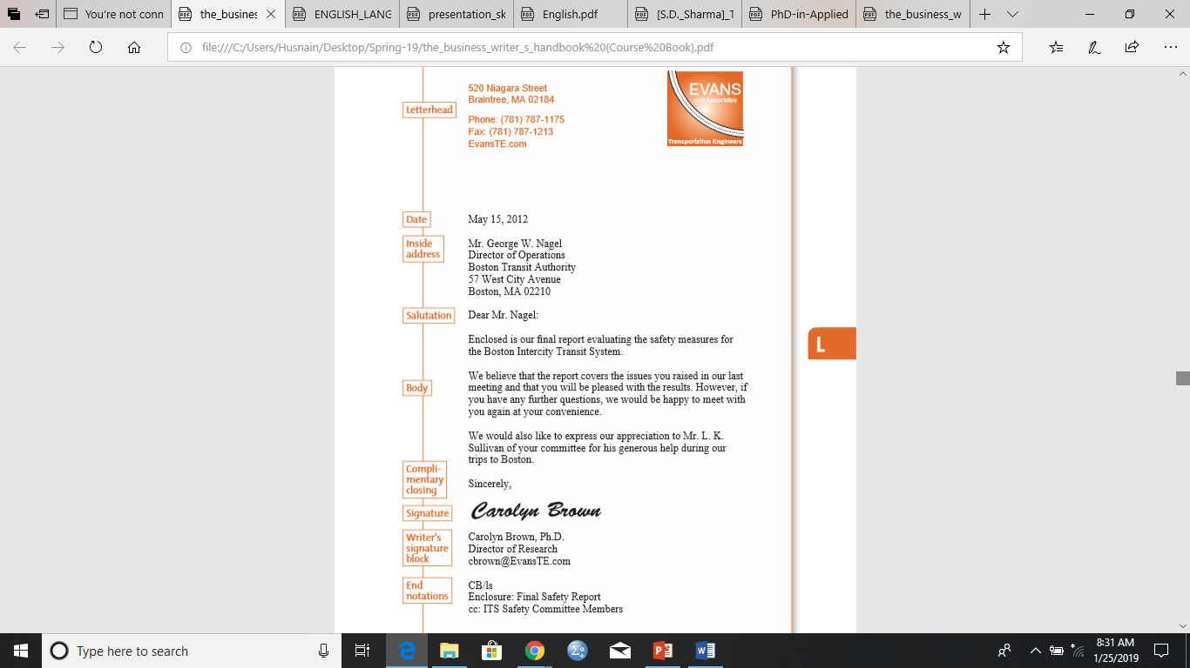
Full Block Style with Letterhead
Notes:
Focus on the date….when the letter is on the letterhead, date comes at first…if letterhead is not there then date comes right after the sender’s address
Leave single-space after every section
All the sections are left-aalligned.

Slide 9
Parts of a Letter
Letterhead of your Organization
Date
Inside Address
Subject Line
Salutation
Body
Complimentary Closing
Writer’s Signature Block
Your full name (typed)
End Notations CC
Notes:
1- LetterHead: if no letter head place return address.
1_1- Give Four line space
3- Inside Address: Recipient Name, title and Address
5- Salutation: Dear Mr Ali:
6- Body: Purpose, detail, call for action, closing off.
7- Closing: Yours sincerely, or Best Regards, or Best,
7_1- Give Four line space
9- May Add business Designation/email/phone.
10- Writter Initials (capitals) / typer initials (small)
Attached Document (Enclosure: Final Safety Report) (if neccessary)
cc and bcc (if neccessary)
cc: original receiver is told of the persons receiving the copies
bcc: original receiver is not told of the persons receiving the copies (not mentioned on the original)
Note: If there is a second page Put recipient name, pg no, date on top.

Slide 10
Heading or Letterhead
Place your full return address and the date in the heading (if no letterhead).
Avoid writing name (your name appears at the end of the letter)
Spell out words such as street, avenue, first, and west rather than abbreviating them.
The date usually goes directly beneath the last line of the return address. Avoid abbreviating the name of the month.
Begin the heading about two inches from the top of the page.
If you are using letterhead that gives the company address, enter only the date, below the last line of the letterhead.

Slide 11
Inside Address
the recipient’s full name
Title/designation
address in the inside address,
One line below the date, depending on the length of the letter

Slide 12
Subject Line
An optional element in a letter is a subject line.
It follows the recipient’s address
Insert one blank line above and one blank line below the subject line.
The subject line in a letter functions as an aid in focusing the topic and filing the letter.
Subject lines are especially useful if you are writing to a large company and do not know the name or title of the recipient. In such cases, you may address a letter to an appropriate department or identify the subject in a subject line and use no salutation.
Notes:
(For information on subject lines, read pages 122–123 of The Business Writer's Handbook.)

Slide 13
Salutation
In most business letters, the salutation contains the recipient’s personal title (such as Mr., Ms., Dr.) and last name, followed by a colon (:).
If you are on a first-name basis with the recipient, use only the first name in the salutation.
Address women as Ms. unless they have expressed a preference for Miss or Mrs.
Professional titles (such as Professor, Senator, Major) take precedence over Ms. and similar courtesy titles.
When a person’s first name could refer to either a woman or a man, one solution is to use both the first and last names in the salutation.
Avoid “To Whom It May Concern” because it is impersonal and dated.
Dear Professor Ali and Dr. Alishba: [two recipients], Dear Ms. Asma, Ms. Aleena, and Mr. Asim: [three recipients], Dear Colleagues: [Members, or other suitable collective term].
In other circumstances in which you do not know the recipient’s name, use a title appropriate to the context of the letter, such as Dear Customer or Dear IT Professional.
Dear Sir/Madam
Notes:
Place the salutation, or greeting, below the subject and the inside address and align it with the left margin.

Slide 14
Body
The body of the letter should begin a line below the salutation
Leave a line within paragraphs
To provide a fuller appearance to a very short letter, you can increase the side margins, increase the font size and insert extra space above the inside address, the writer’s signature block, and the initials of the person typing the letter..
Components of Body:
Purpose
Details
Call for Action
Closing off
Notes:
Also read about the ABC format in the Correspondence guidelines.

Slide 15
Complimentary Closing
Type the complimentary closing a space below the body.
Use a standard expression such as Sincerely, Yours sincerely or Yours truly.
If the recipient is a friend as well as a business associate, you can use a less-formal closing such as Best wishes or Best regards or, simply, Best.
Capitalize only the initial letter of the first word, and follow the expression with a comma (,).

Slide 16
Writer’s Signature Block
Type your full name four lines below and aligned with the complimentary closing.
Sign the letter in the space between the complimentary closing and your name.
On the next line include your business title, if appropriate.
The following lines may contain individual contact information, such as a telephone number or an e-mail address, if not included in the letterhead or the body of your letter.

Slide 17
End Notations
Reference initials show the letter writer’s initials in capital letters, followed by a slash mark (or colon), and then the initials of the person typing the letter in lowercase letters (When the writer is also the person typing the letter, no initials are needed).
Enclosure notations indicate that the writer is sending material along with the letter (an invoice, an article, and so on).
Enclosure notations may take several forms: Enclosure: Final Safety Report
Copy notation (“cc:”) tells the reader that a copy of the letter is being sent to the named recipient(s).
Use a blind-copy notation (“bcc:”) when you do not want the addressee to know that a copy is being sent to someone else. A blind-copy notation appears only on the copy, not on the original (“bcc: Dr. Ali Afzal”).
Notes:
Business letters sometimes require additional information placed at the left margin.
two spaces below the typed name and title of the writer in a long letter, four spaces below in a short letter.

Slide 18
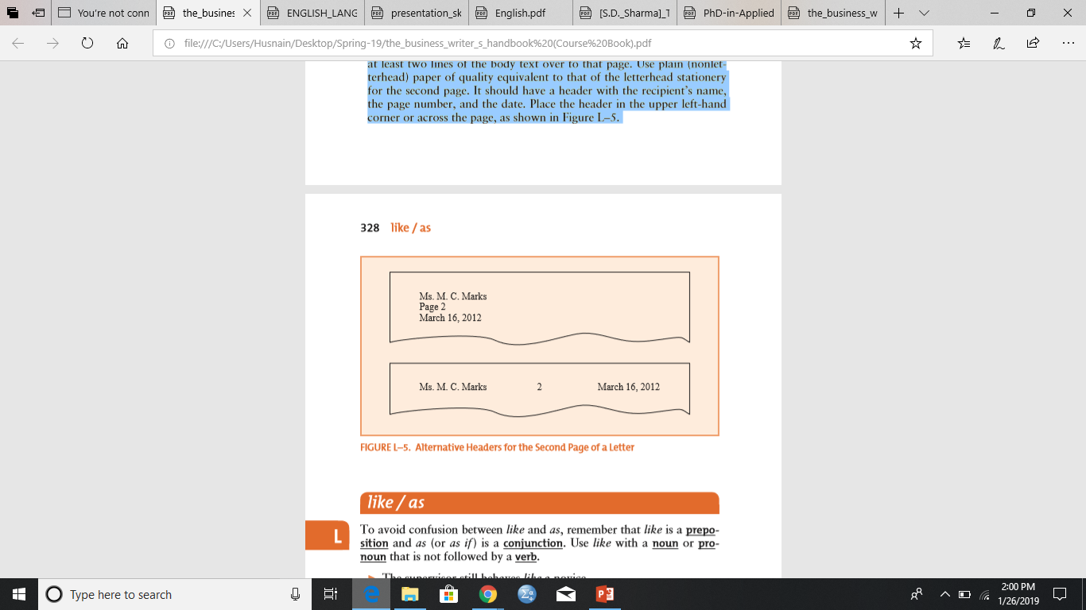
Continuing Pages
If a letter requires a second page (or, in rare cases, more), always carry at least two lines of the body text over to that page.
Use plain (non-letterhead) paper of quality equivalent to that of the letterhead stationery for the second page.
It should have a header with the recipient’s name, the page number, and the date. Place the header in the upper left-hand corner or across the page.

Slide 19
Types of Letters

Slide 20
1. Acknowledgement Letter
When a client sends you something or makes a request, you should acknowledge what was sent, respond to the request, or explain that you cannot respond to the request immediately in a short, polite note.
A letter of acknowledgement is both a receipt and a public relations tool
Its objective is to let the reader know that items requested in a prior communication, usually an inquiry or an order letter, have been received.
To complete a business communication cycle.
Should be written on the same day

Slide 21
SocialSquare Pvt.Ltd
Phase III DHA
Jan 28, 2019
Ms. Ayesha
B-Block Faisal Town,
Lhr
Dear Ayesha,
When I ﬁnish studying it in detail, I’ll send you our cost estimate for the installation of the Checkout Reporting System. I am writing this letter to say that I have received the receipt of your comprehensive report that was sent on December 20, 2018. Thank you for preparing such a thorough analysis.
Obediently,
Amir Shehzad
0000-0000000

Slide 22
Social Square Private Limited
Phase III Defense Housing Authority,
Lahore
January 28, 2019
Ms. Ayesha Khan
Director
B-Block Faisal Town
Lahore
Dear Ms. Ayesha:
I am writing this letter to acknowledge the receipt of your comprehensive report.
When I ﬁnish studying it in detail, I will send you our cost estimate for the installation of the Checkout Reporting System.
Thank you for preparing such a thorough analysis.
Regards,
Amir Shehzad

Slide 23
2. Complaint Letter
A complaint letter advises the reader of an error in a business transaction or a defect discovered in a consumer product or service.
The objective is to provide detailed information regarding the error or defect and to serve as a legal document recording the writer's claim and the corrective action or adjustment being requested.
Keep in mind that your reader is a trained customer service professional and not very likely to be the person responsible for the error or defect.
Rather than being angry, use a firm but courteous tone when stating a complaint. Remember, you want results, not a fight.
The scope of a complaint letter should include only those facts that validate your claim and a request that corrective steps be taken.
It may also detail the options that you are willing to accept in satisfaction of the claim.

Slide 24
Complaint Letter
Describes a problem that the writer requests the recipient to solve.
The tone of a complaint letter or e­mail is important; the most effective ones do not sound complaining.
If your message is harsh and argumentative you may not be taken seriously.
Assume that the recipient will be reliable in correcting the problem. However, anticipate reader reactions or refutations
I reviewed my user manual’s “safe operating guidelines” carefully before I installed the device. [This assures readers you followed instructions.]
Without such explanations, readers may be tempted to dismiss your complaint.

Slide 25
288-F11,
Islamabad
Aug 28
Social Square Private Limited
Phase III Defense Housing Authority,
Lahore
Dear Customer Support:
On July 11, I ordered nine Diagnostic Scanners (order # ST3-1179R). The scanners were ordered from your customer Web portal. On August 3, I received seven Monitors from your parts warehouse in Islamabad, Pakistan. I immediately returned those Monitors with a note indicating that a mistake had been made. However, not only have I failed to receive the Scanners that I actually ordered, but I have also been billed for the seven Monitors. I have enclosed a copy of my conﬁrmation e-mail, the shipping form, and the most recent bill. If you cannot send me the Scanners I ordered by September 15, please cancel my order.
Sincerely,
Aqib Tahir

Slide 26
288-Sector F11,
Islamabad
August 28, 2018
Customer Support
Social Square Private Limited
Phase III Defense Housing Authority,
Lahore
Dear Customer Support:
Subject: Diagnostic Scanners Delivery
I am writing this letter to bring the issue of wrong items delivery under your consideration.
On July 11, I ordered nine Diagnostic Scanners (order # ST3-1179R). The scanners were ordered from your customer Web portal. On August 3, I received seven Monitors from your parts warehouse in Islamabad, Pakistan. I immediately returned those Monitors with a note indicating that a mistake had been made. However, not only have I failed to receive the Scanners that I actually ordered, but I have also been billed for the seven Monitors.
I have enclosed a copy of my conﬁrmation e-mail, the shipping form, and the most recent bill. If you cannot send me the Scanners I ordered by September 15, please cancel my order.
Sincerely,
Aqib Tahir

Slide 27
3. Adjustment Letter
An adjustment letter or e-mail is written in response to a complaint and tells a customer or client what your organization intends to do about the complaint.
Although sent in response to a problem, an adjustment letter actually provides an excellent opportunity to build goodwill for your organization.
An effective adjustment letter can not only repair any damage done but also restore the customer’s confidence in your company.
No matter how unreasonable the complaint, the tone of your response should be positive and respectful.
Avoid emphasizing the problem, but do take responsibility for it when appropriate.
Focus your response on what you are doing to correct the problem.
Settle such matters quickly and courteously, and lean toward giving the customer or client the benefit of the doubt at a reasonable cost to your organization.

Slide 28
Example: Full Adjustment (When company is at fault)

Slide 29
Dear Mr. Basit:
We are sorry that your experience with our customer support help line did not go smoothly. We are eager to restore your conﬁdence in our ability to provide dependable, high-quality service. Your next three months of Internet access will be complimentary as our sincere apology for your unpleasant experience.
Providing dependable service is what is expected of us, and when our staff doesn’t provide quality service, it is easy to understand our customers’ disappointment. I truly wish we had performed better in our guidance for setup and log-on procedures and that your experience had been a positive one. To prevent similar problems in the future, we plan to use your letter in training sessions with customer support personnel.
We appreciate your taking the time to write us. It helps to receive comments such as yours, and we conscientiously follow through to be sure that proper procedures are being met.
We believe you will enjoy best of our services.

Slide 30
Example: Partial Adjustment (When company is at fault)

Slide 31
Dear Mr. Saim:
Enclosed is your Hair Laptop Computer, which you shipped to us on August 31.
Our technical staff reports that the laptop was damaged by exposure to high levels of humidity. You stated in your letter that you often use your laptop on a covered courtyard. Doing so in a high-humidity environment, as is typical in Islamabad, can result in damage to the internal circuitry of your computer as described on page 32 of your Hair Owner’s Manual.
We have replaced the damaged circuitry and thoroughly tested your laptop. To avoid similar problems, we recommend you avoid leaving your laptop exposed to high humidity for extended periods.
If you ﬁnd that the problem recurs, please call us at 000-000-0000. We will be glad to work with you to ﬁnd a solution.

Slide 32
Letter vs Memo
Letter
Memo
A memo is used internally within an organization moving upward, downward or horizontally. It is never sent outside.
A memo may omit return address, salutation, complimentary close if it uses To, from, Date and Subject heading.
Memo can use technical jargons and abbreviations because their meaning is understood by the people within the organization.
Letters are used both external communication (mostly)
A letter requires inside address, Salutation and complimentary close.
Communicating to external people through letter, simple words are encouraged rather than jargons.

Slide 33
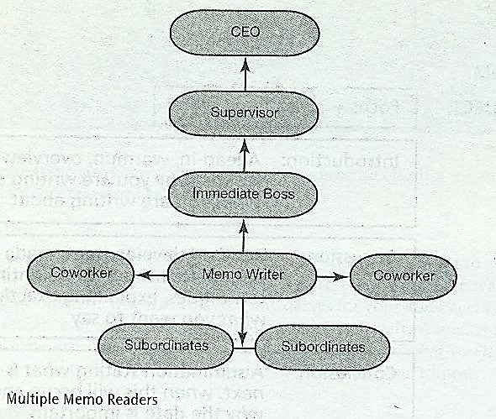

Slide 34
PURPOSES
Documentation – report on expenses, incidents, accidents, problems encountered, projected costs, study findings, hiring, firings, and relocation of staff or equipment. | Procedures – explain how to set up accounts, operate new machinery, use new software, create a new company Web site, or solve a problem.
Cover/transmittal – tell the reader you have attached a document. | Confirmation – tell the reader about a meeting agenda, date, time, and location; decision to purchase or sell; conclusion arrived at; and fees, costs or expenditure.
Feasibility – study the possibility of changes in the workplace (practices, procedures, location, staffing, equipment, mission or visions). | Status – provide a daily, weekly, monthly, quarterly, biannual, or yearly progress report about sales, staffing, travel, practices, procedures and finances.
Recommendations – provide reasons to purchase new equipment, fire or hire personnel, contract with new providers, merge with other companies, revise current practices and review contracts. | Inquiry – ask questions about upcoming processes, procedures, or assignments

Slide 35
Memos should contain the following key components:
Memo ID
Introduction
Discussion
Conclusion
DATE:
TO:
FROM:
SUBJECT:
Focus + Topic
Introduction: A lead-in, warm up, overview, stating why you are writing and what you are writing about
Discussion: Detailed development, made accessible through highlighting techniques, explaining exactly what you want to say
Conclusion: A summation stating what is next, when this will occur, and why the date is important

Slide 36
EXAMPLES
One-word subject lines don’t communicate effectively, e.g.
Flawed: Subject: COMPTROLLERS
Corrected: Subject: Salary Increase For Comptrollers
Introduction - example
In the third of our series of quality control meetings this quarter, I’d like to get together again to determine if improvements have been made.
As a follow-up to our phone conversation yesterday (8/12/05). I have met with your VP regarding your suggestions, He’d like to meet with you to discuss the following ideas in more detail.

Slide 37
EXAMPLES
Conclusion
A complimentary close: If our quarterly sales continue to improve at this rate, we will double our sales expectations by 2005. Congratulation!
A directive close: Next Wednesday (12/22/05), Mr. Jones will provide each of you a timetable of events and a summary of accomplishments.

Slide 38
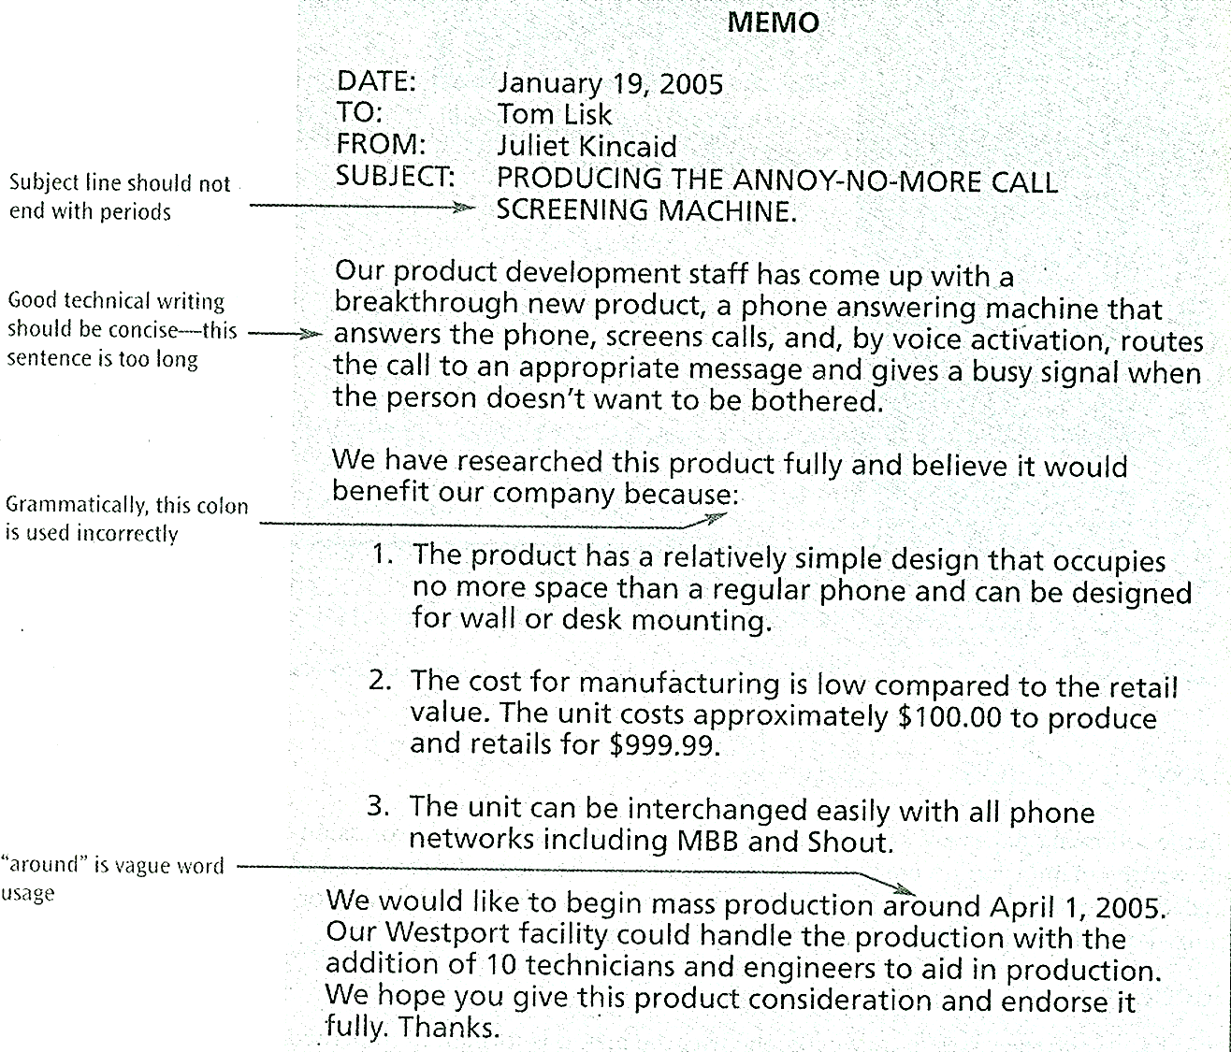

Slide 39
Group Task
Group-1 You as CEO of Avanceon Private Limited (Gulberg-II, Lahore) has outsourced your project of developing Salary Management program to Social Square (Phase III-DHA, Lahore). After the first month of successful installation and testing, the software faced an error. Assume terms of contract and ask your personal assistant (Mr. Kaleem) to write a complaint letter to Manager Customer Support (Mr. Adil Rizwan). Your complaint letter will identify that you have also sent a copy to CEO Social Square (Mr. Avais) and enclosed a screenshot of error screen.
Group-2 You are the Manager Customer Support of Social Square (Phase III-DHA, Lahore). You have received a Complaint letter on January 28, 2019 from CEO of Avanceon Private Limited (Gulberg-II, Lahore) about your company’s product. Ask your personal assistant (Mr. Asad Irfan) to write an acknowledgement letter to the CEO Avanceon Private Limited (Gulberg-II, Lahore). Also ask you secretary (Mrs. Nadia Ali) to write a memo to Manager product development (Mrs. Naveed) of your company, informing her about the complaint. While you are writing both letters consider about all legal aspects due to which you will be identifying, producing and sending more than one copies and enclosing documents.

Slide 40
Group Task
Group-3. You as a product development manager of Social Square (Phase III-DHA, Lahore) to show goodwill gesture with your team have visited Avanceon Private Limited (Gulberg-II, Lahore) for the review of the product. After reviewing the software you found an attempt of hacking from one of the Avanceon’s computer IP address which resulted in the error. Now you have asked your secretary (Ms. Amna Ilyas) to write a memo to customer support manager (Mr. Adil Rizwan) to take decision according to the company’s policies. Your memo will include information of all the concerned authorities requiring the update about the situation and enclose the field visit report.
Group-4. You as Customer Support Manager of Social Square (Phase III-DHA, Lahore) writing an adjustment letter to CEO of Avanceon Private Limited (Gulberg-II, Lahore) your objective will be to keep Avanceon as your longterm customer. You can make assumptions. Your letter will be keeping key personnel in the loop and will be attaching the previous conversational documents.

Slide 41
GROUPS | DOCUMENTS TO SUBMIT | SEND TO
Group 1 | Complaint Letter | Group 2
Group 2 | Acknowledgement Letter Memorandum | Group 1 Group 3
Group 3 | Memorandum | Group 4
Group 4 | Adjustment Letter | Group 1
All documents will be exchanged through emails, following the email etiquettes
The instructor email always be added in CC
Decide on a representative from each group who will send and receive emails, and share their email addresses with the representative of other groups
All groups will be completing the tasks in a weeks time. The group causing the delay in response will be penalized.

